Slide 1
Bridging Social Dissonance by Disseminating Harmony:
The CST Core Principles Through Song
Carolyn Cleary

Slide 2
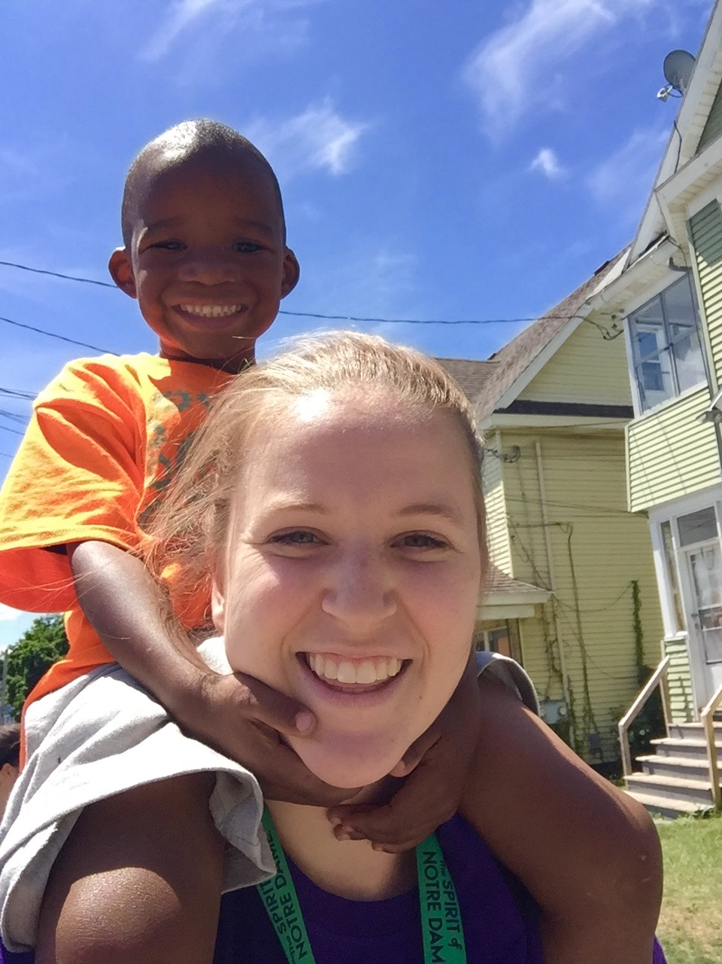
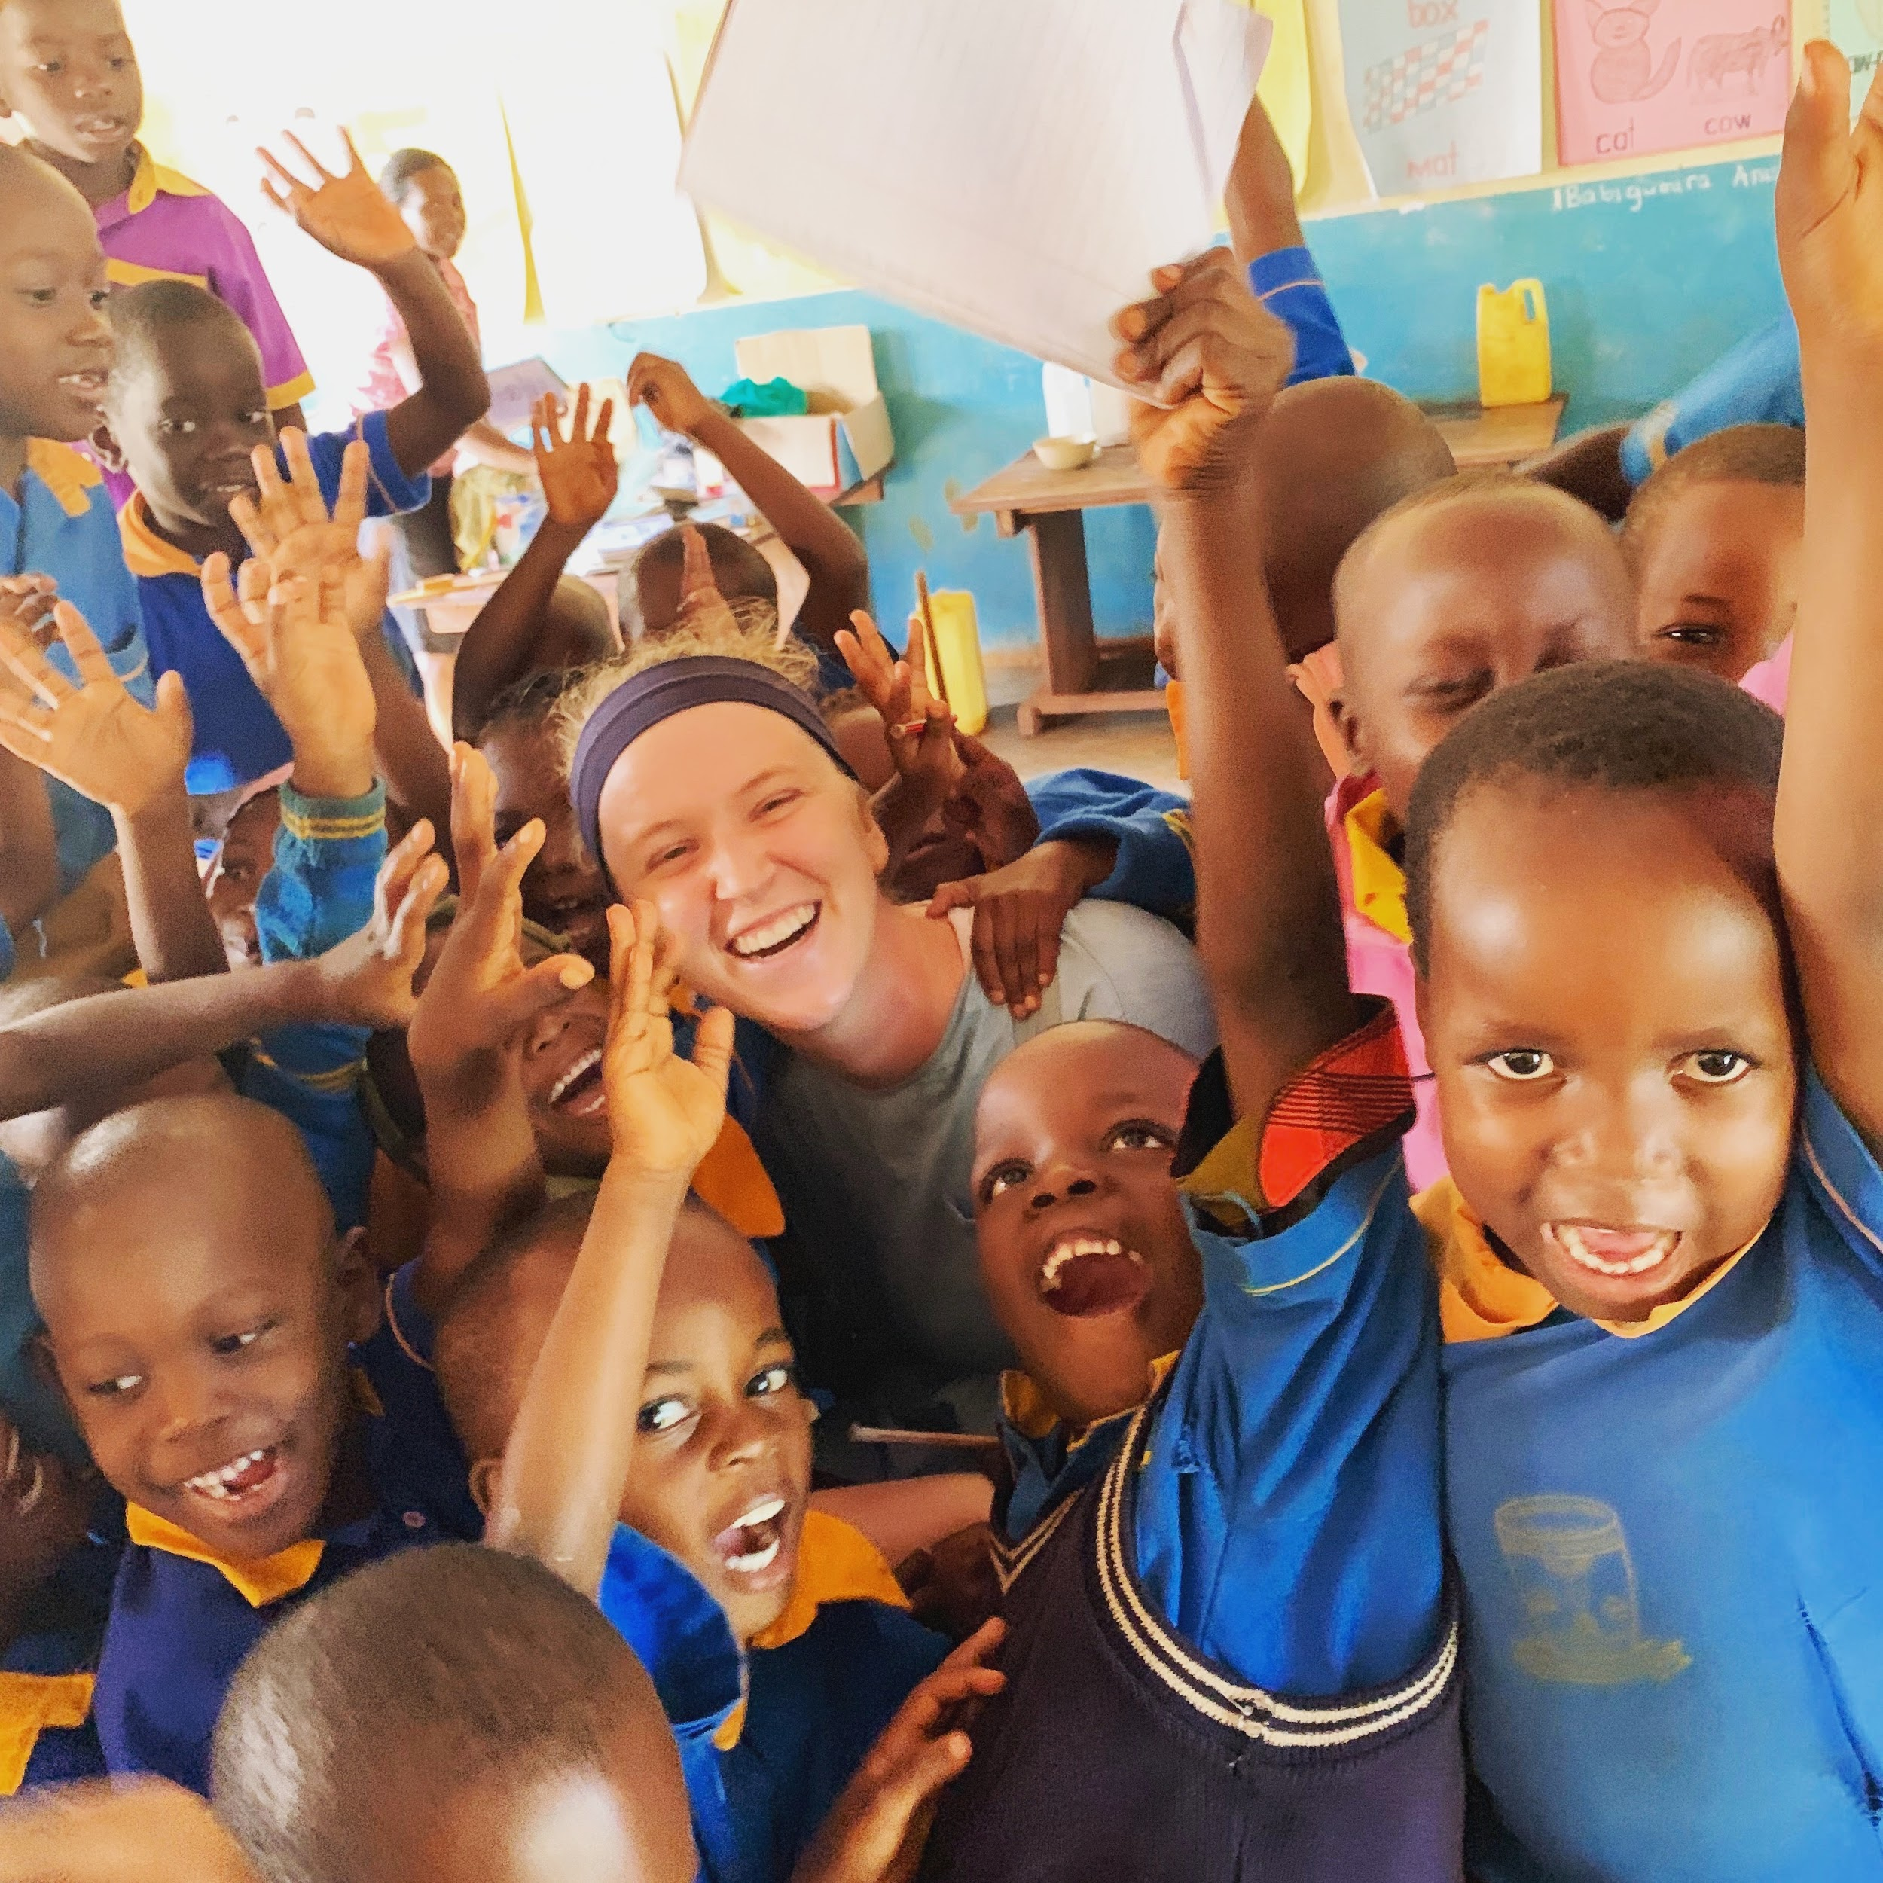
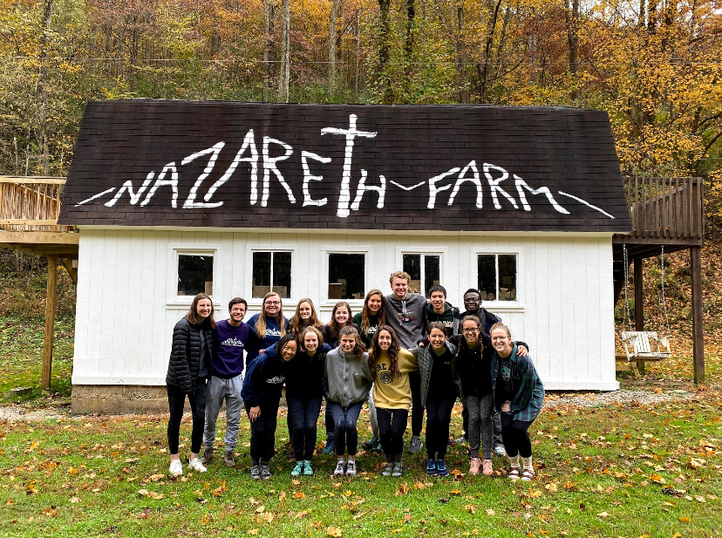
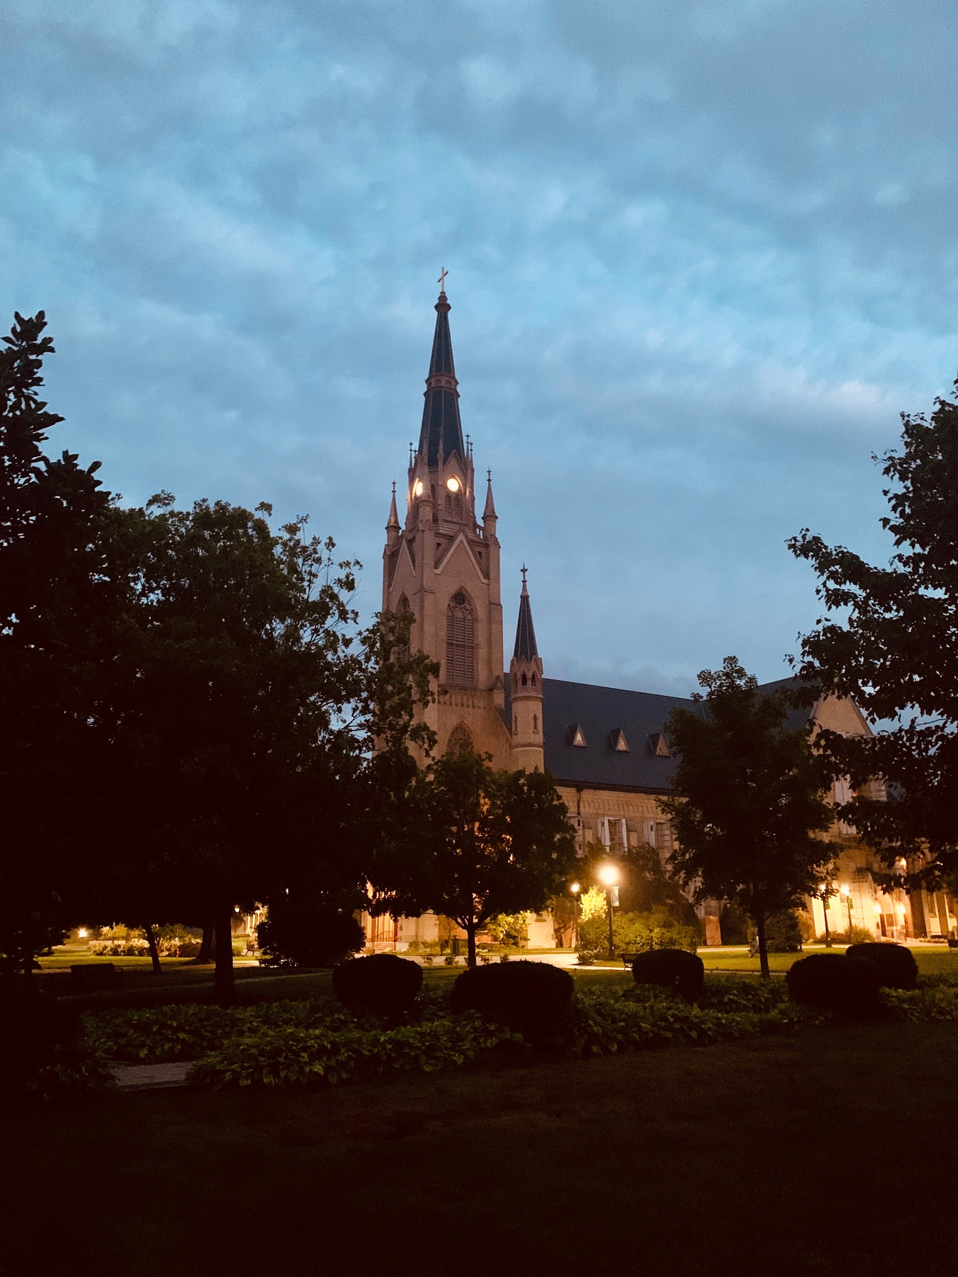
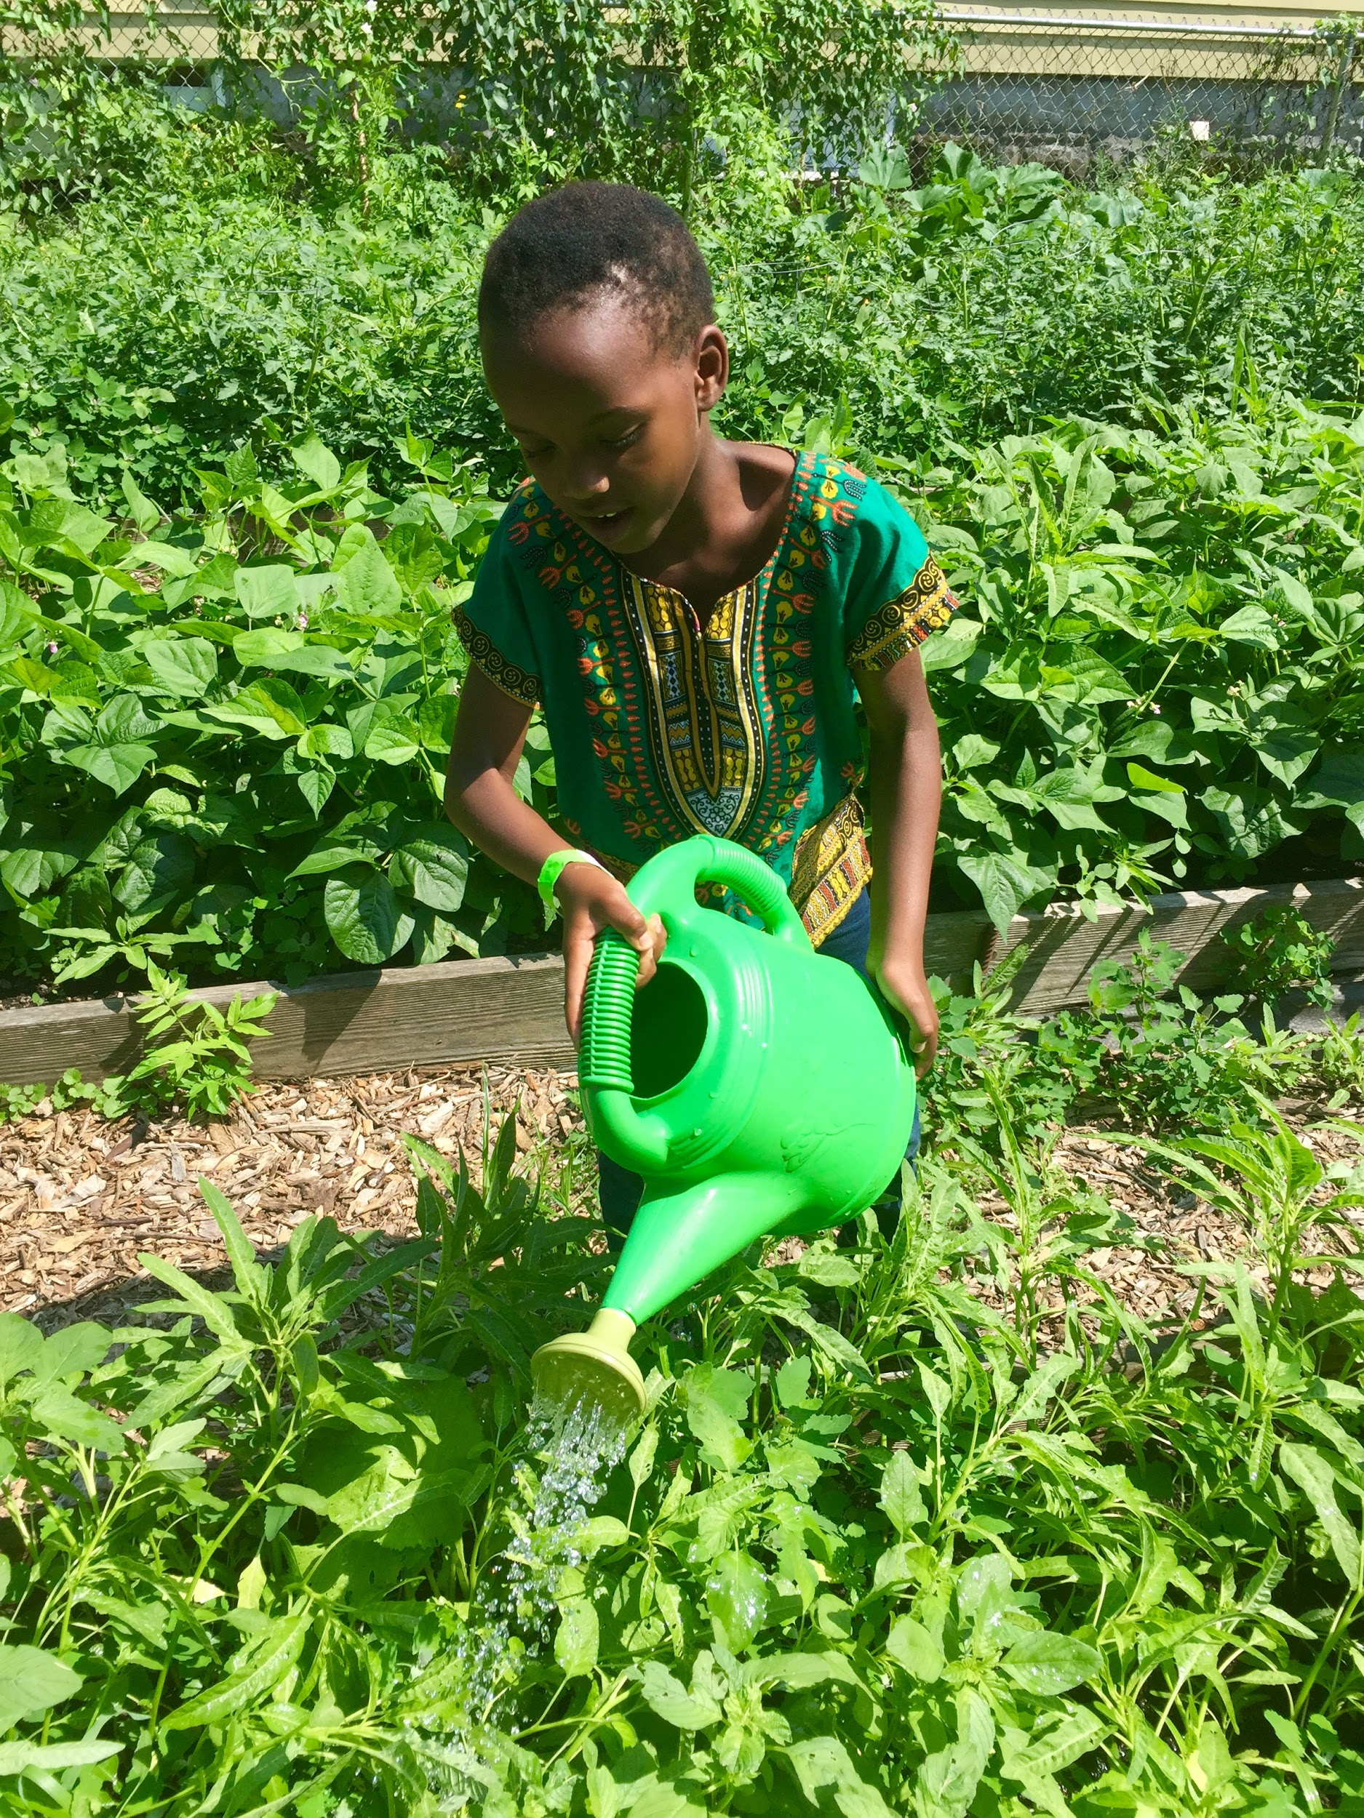
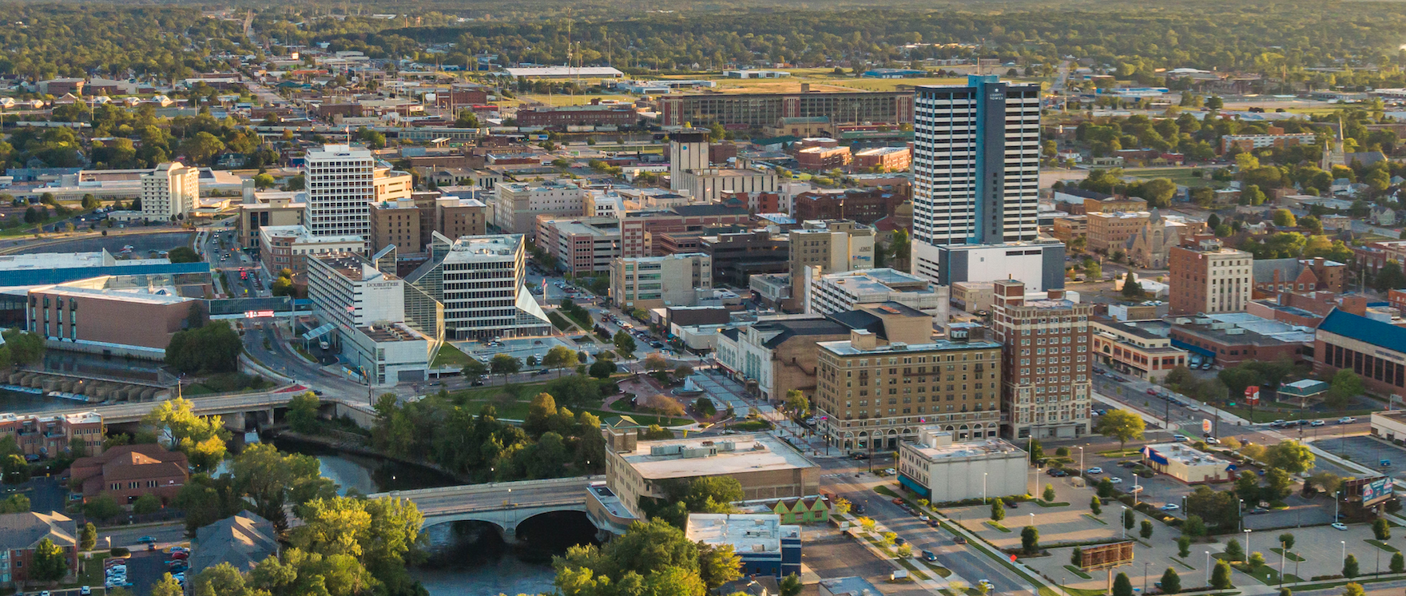
My CST Experience

Slide 3
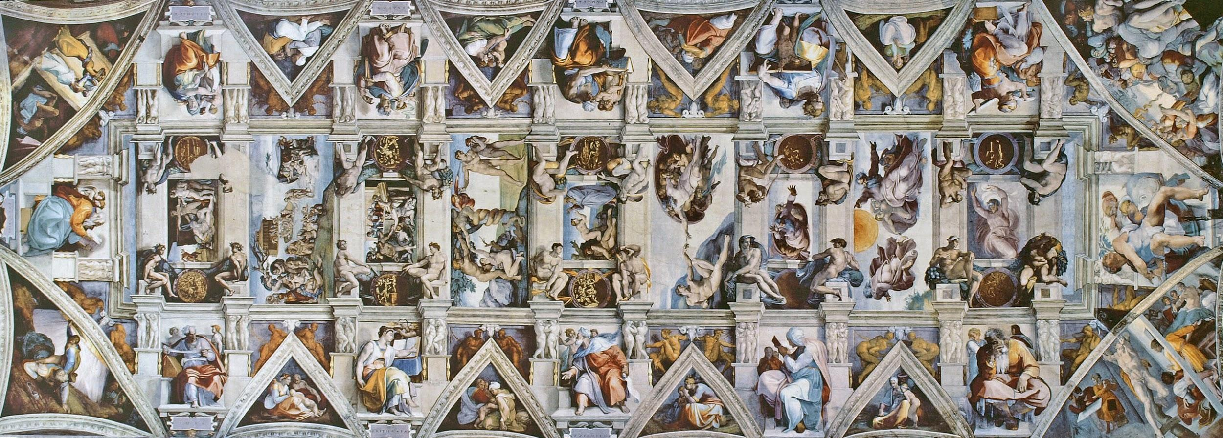
Role of Music and the Arts in the Church
My Own Experience
Music/Art can serve as an avenue to articulate ideas and feelings about complex theoretical topics that are difficult to explain.
Music/Art as a universal language
Music/Art is communal
Music/Art as a prayer---repetition, reflection, expression

Slide 4
Goals of My Capstone
Mirror the Call to Action in CST texts in music
Create an album in community despite being physically separated by the global pandemic
Create pieces that can be disseminated to and enjoyed by any audience that is learning about CST principles.

Slide 5
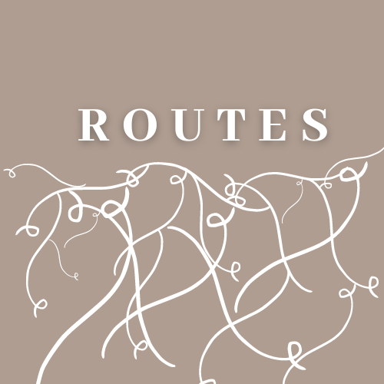
The Album
-Seven Pieces--Seven Principles
Instrumentation
-Incorporation of an array of music genres
- Emphasis on a vast target audience
Community Lyrics
Collection via Google Survey
Combination of archetypes

Slide 6
Incorporation of CST Texts with Personal Experiences
Steps of the Process
Gather community perspectives on each principle
Identify archetypes throughout responses
Match common papal encyclicals to each principle
Decide which archetypal elements I could include instrumentally
Write lyrics as a call to action using both the surveys and texts
“I am convinced that music really is the universal language of beauty which can bring together all people of good will on earth.” - Pope Benedict XVI

Slide 7
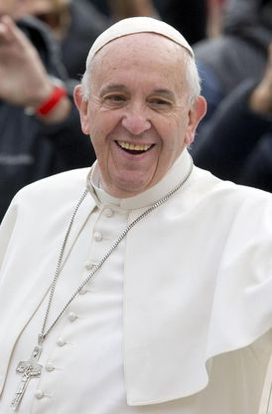
Where We Are
CST Principle Care for Creation
Jazz/ Folk (Replication of imagery through sound)
Archetypes
“ We just all have to do our part”--- Stated by over 100 participants in the survey
Scenic views, ocean, “too busy trying to improve technology at the cost of our environment”
- CST Text: Laudato si’ ---Pope Francis
- Responsibility of all
- “on care for our common home”
- Problem with focusing on progress

Slide 8
Goals for Dissemination
- Public music platform distribution
-Easily accessible to parishes, schools, families etc. that have Internet capabilities
Further Steps
How could I distribute this music to audiences that do not have access to the internet?
Use of music as a language to express and understand other faith traditions

Slide 9
Questions?

