Slide 1
Mutually Transformative:
L’Arche and the Preferential Option for the Poor
Emma Bosch

Slide 2
About L’Arche
Founded in France in 1964
Today: 153 communities, 38 countries
Mission statement: Make known the gifts of people with intellectual disabilities, revealed through mutually transforming relationships
Terms: Core member, assistant

Slide 3
Preferential Option for the Poor
Definition of preferential option for the poor (Centesimus Annus, Economic Justice for All)
Central to the pursuit of justice (Centesimus Annus)
Call for attention (Populorum Progressio)

Slide 4
Vanier and Poverty
Particular vulnerability of the disabled
Resulting call to community
Relationship with the poor as a recognition of God’s presence
Relationship with the vulnerable allows us to encounter our own vulnerability
International solidarity

Slide 5
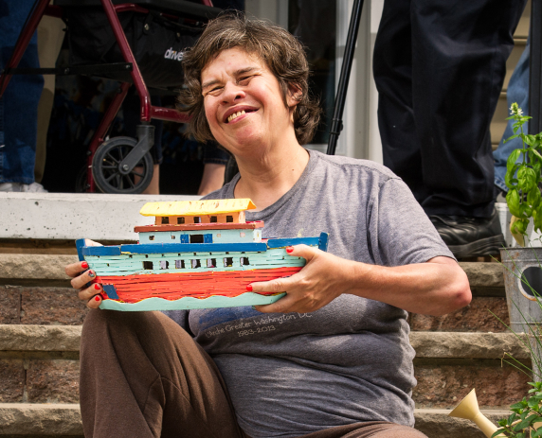
Role of Core People and Signs of the Times
Allegations of abuse against Jean Vanier
Role of core persons in the future of L’Arche

