Slide 1
Bringing the Common Good into the Common Core
Exploring CST in the field of education
Monica VanBerkum

Slide 2
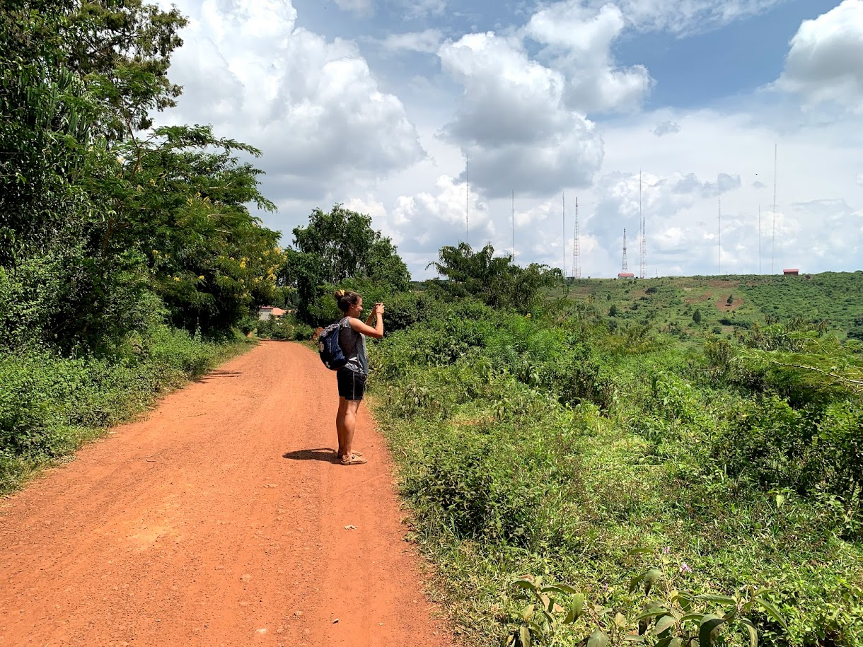
Inspiration
“Christianity in Africa” with Fr. Paul Kollman, CSC
Summer in Jinja, Uganda
Conversations with professors
YA Literature class

Slide 3
CST Connection
“In the diversity of peoples who experience the gift of God, each in accordance with its own culture, the Church expresses her genuine catholicity” (Evangelii Gaudium #115).
…a need for interaction and dialogue between cultures, emphasizing that the dialogue, “if it is to be effective, has to set out from a deep-seated knowledge of the specific identity of the various dialogue partners” (Caritas in Veritate #26).
…subsidiarity “respects personal dignity by recognizing in the person a subject who is always capable of giving something to others” (Caritas in Veritate #57).

